Slide 1
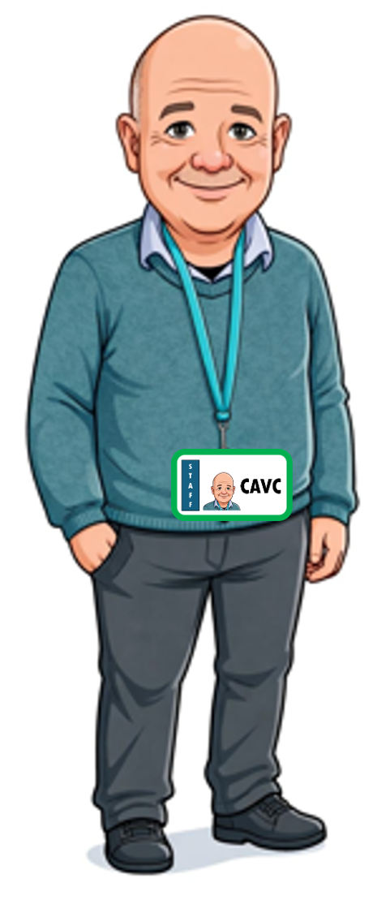
16) ESCC1P16 2025-2026 Thu 25 June 2026

Slide 2
Check-in
Thu 25 June 2026

Slide 3
Reading & Writing
17:45 – 20:45

Slide 4
Plus Int Letter of Enquiry.pptx
English Grammar In Use Unit 46 Have Something Done.pdf
English Grammar In Use Unit 46 Have Something Done.pptx

Slide 5
Direct Question How big is the screen?
Indirect Question
Expression of interest
I would like to know
Could I ask
May I ask
Could you tell me
Please tell me
… I would like to ask
Question Word
If/Whether
. . .
how big
if
what
how long
whether
if
the screen is.
delivery is included in the price?
the storage capacity is?
the video is?
the case is included in the price.
it is possible to connect the camera with any photo printer.

Slide 6
Check-out
Thu 25 June 2026

Slide 7
Using Plus Int Letter of Enquiry.pptx, we
learnt how to write a letter asking for information, and
ask indirect questions.
Using English Grammar In Use Unit 46 Have Something Done.pptx slides 1-9, we
practiced have/get something done.
Homework
indirect questions Ex 3. Write as an email rather than a letter. The email address is: weselltravelbags.co.uk.
See the next slide.

Slide 8
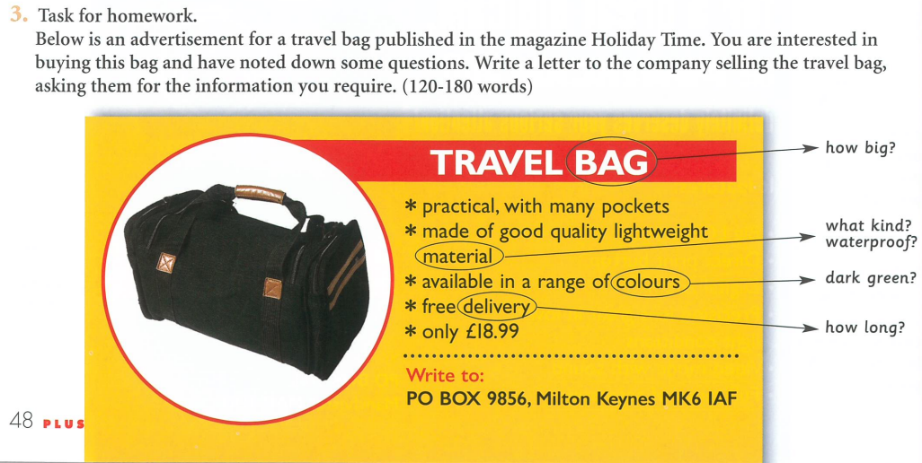
Email: weselltravelbags.co.uk
For further information.

